Slide 1
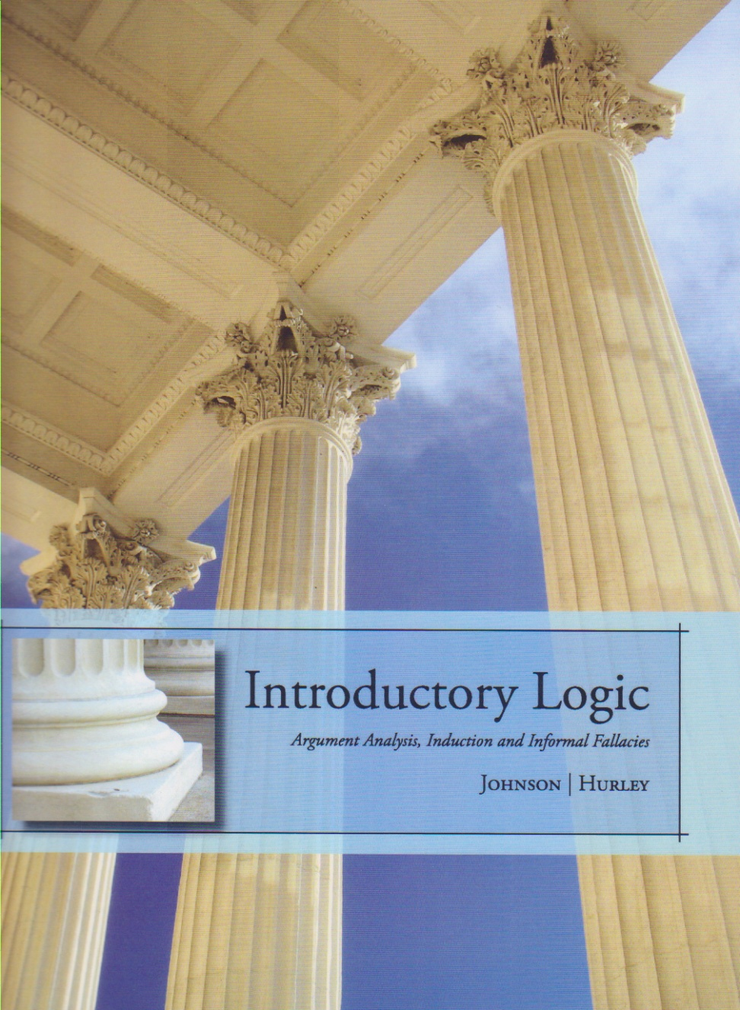
Presentation: Fallacies – Ambiguity

Slide 2
Homework
Recommended Exercises (do the starred problems)
4.4.III: 1-50
Model exercise for the exam
Remember
How does each specific argument commit a fallacy of that type?
Where precisely is the offending element in the argument?

Slide 3
Kinds of Informal Fallacies
See pages 153f for a complete list
Fallacies of:
Relevance
Weak Induction
Presumption
Ambiguity
Amphiboly/Equivocation
Whole/Part
Only required to classify each fallacy according to these four types

Slide 4
Kinds of Informal Fallacies
See pages 153f for a complete list
Fallacies of:
Relevance
Weak Induction
Presumption
Ambiguity
Amphiboly/Equivocation
Whole/Part
Only required to classify each fallacy according to these four types

Slide 5
Fallacies of Ambiguity
Of a particular word or phrase
Equivocation
Of a whole sentence or sentence part
Amphiboly

Slide 6
Equivocation
Equivocation
A defect (in argumentation) occurring because of a shift in the meaning of a term or a phrase in an argument
Fallacies of Ambiguity

Slide 7
Where is the equivocation?
Reverend Smith married six people yesterday. The man should obviously be locked up, since he is apparently a committed bigamist.

Slide 8
Where is the equivocation?
Reverend Smith married six people yesterday. The man should obviously be locked up, since he is apparently a committed bigamist.
To “marry”
I married my wife
The reverend married us

Slide 9
amphiboly
Amphiboly
An (inferential) error founded on a grammatical ambiguity
Fallacies of Ambiguity or Whole/Part

Slide 10
Amphiboly
Professor Lang offered a course on the increase of heart disease in the biology building over the last twenty years. I think the building should be off limits, if there really has been an increase of heart disease in it over the years. No member of the university should be put at such risk.

Slide 11
Amphiboly
One morning I shot an elephant in my pajamas. How he got into my pajamas I'll never know.
Groucho Marx in the movie Animal Crackers.

Slide 12
Fallacy of Ambiguity
There’s a sign in the Johnson Athletic Center that says if you use one of the Precor training machines you will be producing electricity that will be pumped into the Center’s own electric grid. This is an effort on the part of the University to create a greener environment. I think the University could do much better. If they were really committed to green technology, they would hook up all the Precor training machines to the grid instead of just one.

Slide 13
Fallacy of Ambiguity
There’s a sign in the Johnson Athletic Center that says if you use one of the Precor training machines you will be producing electricity that will be pumped into the Center’s own electric grid. This is an effort on the part of the University to create a greener environment. I think the University could do much better. If they were really committed to green technology, they would hook up all the Precor training machines to the grid instead of just one.

Slide 14
Whole/Part Fallacies
Composition
Division
(of the whole)
(to the part)
Fallacies of Ambiguity or Whole/Part

Slide 15
Fallacies of Grammatical Analogy
Composition
To improperly conclude that
a property true of a part of some whole applies in the same manner to the whole
Division
To improperly conclude that
a property true of the whole applies in the same manner to one of its parts

Slide 16
Composition or Division
Every part of the machine is light, therefore the machine as a whole must be light.

Slide 17
Composition or Division
Every part of the machine is light, therefore the machine as a whole must be light.
Does the whole composed of light parts have that property?
Fallacy of Composition

Slide 18
Composition or Division
Conventional weapons have killed more people than nuclear weapons, therefore these pistols are more dangerous than a nuclear weapon.
As a whole, conventional weapons have killed more
Are conventional weapons individually more dangerous than nuclear weapons?
Fallacy of Division

Slide 19
Composition or Division
Have you seen the incoming class of basketball players. They are all superb athletes and excellent at their position. I foresee a great season this year given the high quality of the new players.
Fallacy of Composition

Slide 20
Composition or Division
The engine of my car weighs well over three hundred pounds. So my car weighs at least that much.
Not fallacious

Slide 21
Composition or Division
The concept of a species – Homo sapiens, for instance – is just an abstraction. That is to say, it represents the essence of that kind of thing. Since a species is really nothing more than an abstract idea, it follows that every member of a species is also just an abstraction.
Fallacy of Division

Slide 22
Review
4.4.I (p. 154f)
Do you see the fallacy of ambiguity or grammatical analogy?
Where precisely in the argument is the error?
4.4.III
(model problems for exam)

Slide 23
Homework
Recommended Exercises (do the starred problems)
4.4.III: 1-50
Remember
How does each specific argument commit a fallacy of that type?
Where precisely is the offending element in the argument?
No Class On Wednesday!

