Slide 1
PHI 361 Biology & Society Spring 2011
My Office Hours
Mon/Wed: 11am – 12pm
Tues 2pm – 3pm
(or by appointment)
Bob Sandmeyer, Ph.D.
Office
1429 Patterson Office Tower
Contact Information
bob.sandmeyer@uky.edu
ph. 257-7749
http://sweb.uky.edu/~rsand1/phi361/
https://elearning.uky.edu/

Slide 2
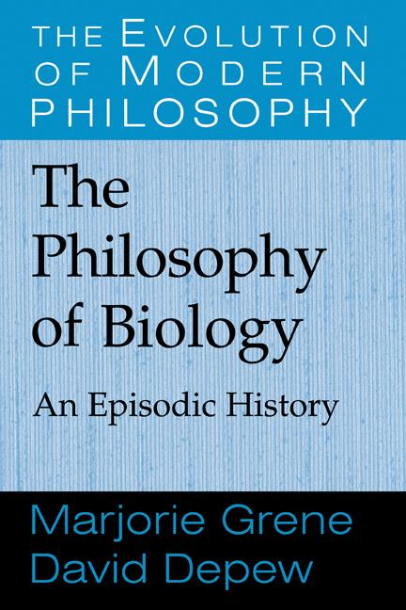
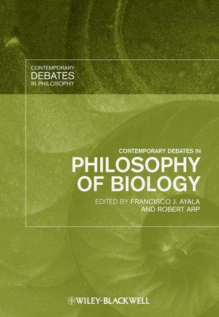
PHI 361 Biology & Society Spring 2011
And articles available through Blackboard

Slide 3
PHI 361 Biology & Society Spring 2011
Homework
Read Chapter 1
Post Bb question

Slide 4
PHI 361 Biology & Society Spring 2011
Graded Elements
Weekly Participation: 20% of total grade
Blackboard Posts: 15%
Daily Participation in Class: 5%

Slide 5
PHI 361 Biology & Society Spring 2011
Grading Scale
A+ 100%
A 95%
A- 90%
B+ 88%
B 85%
B- 80%
C+ 78%
C 75%
C- 70%, &c. &c.
Graded Elements
Essay Exams: 50% of total grade
Midterm: March 1st (20%)
20% of the grade
Final Exam: May 5th (30%)
30% of the grade
Cumulative

Slide 6
PHI 361 Biology & Society Spring 2011
Grading Scale
A+ 100%
A 95%
A- 90%
B+ 88%
B 85%
B- 80%
C+ 78%
C 75%
C- 70%, &c. &c.
Graded Elements
Analysis & Writing: 30% total
Group Presentation: 10%
5-7 page paper: 20%

Slide 7
PHI 361 Biology & Society Spring 2011
Graded Elements
Supplementary Attendance (Extra Credit)
Perfect attendance = +3%
One free unexcused absence
-2% deduction for every unexcused absence thereafter
≥ 5 unexcused absences = failure

Slide 8
PHI 361 Biology & Society Spring 2011
Disability Services
If you have a documented disability which requires academic accommodations, please contact the professor as soon as possible. In order to receive accommodations in this course, you must provide me with a Letter of Accommodation from the Disability Resource Center. If you have not already done so, please register with the Disability Resource Center (Room 2 Alumni Gym, 257-2754, jkarnes@uky.edu) for coordination of campus disability services available to students with disabilities.

Slide 9
PHI 361 Biology & Society Spring 2011
Academic Integrity
Any evidence of plagiarism from any source or cheating in any aspect of this class will result in a zero for the class and may result in a permanent mark on your student transcripts.
Plagiarism Information Sheet
How to Avoid Plagiarism

Slide 10
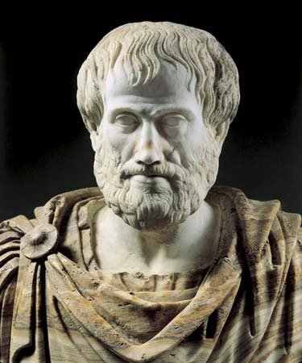
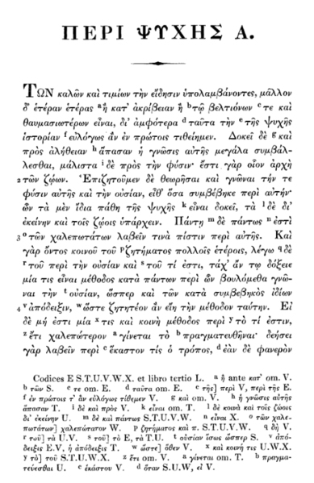
Aristotle
De Anima
(On the Soul)
(384-322 B.C.E.)

Slide 11
Aristotle
Natural objects versus artifacts
"a nature is a type of principle and cause of motion and stability within those things to which it primarily belongs in their own right and not coincidentally." (192b21, 43)
Every natural thing has "within itself a principle of motion and stability in place, in growth and decay, or in alteration." (192b14, 43)

Slide 12
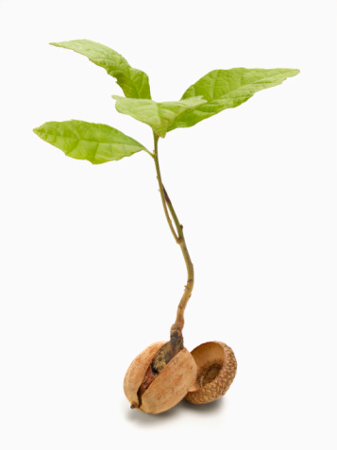
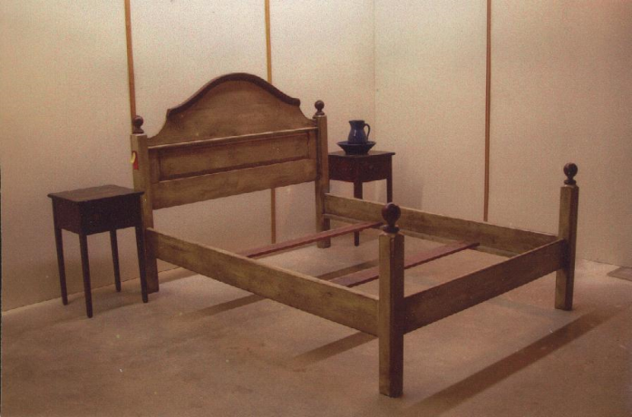
Aristotle
Natural objects versus artifacts
natural things
elements: earth, air, fire, water
other simple bodies
ensouled beings: plants and animals and human beings
artifactual objects
the product of craft, e.g., the bed
has no innate impulse to change
has no principle of its own production
a bed does not come from a bed

Slide 13
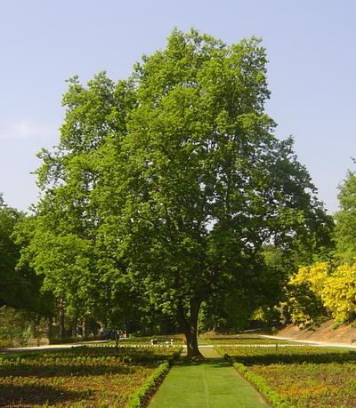
Aristotle
Nature in two senses: matter and form
Matter
the primary constituent present in a thing, i.e., what remains continually while change occurs
Form
the shape, that is, the form given in an account of the thing
form is the nature more than the matter

Slide 14
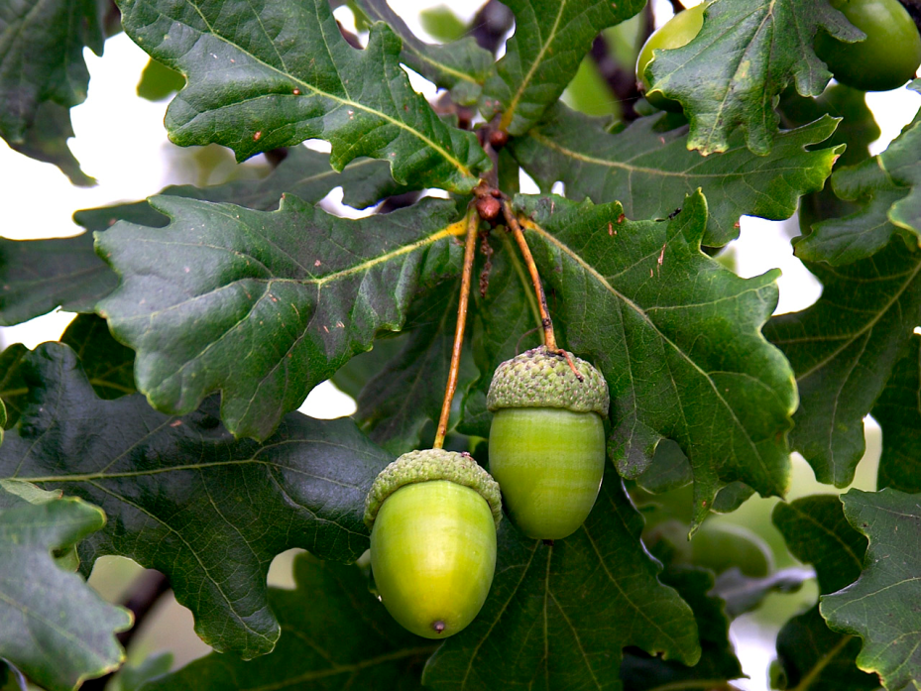
Aristotle
Coming to be (growth)
"nature is of two sorts, nature as matter and nature as form, and the form is the end (telos), and since everything else is for the end, the form must be what things are for." (199a31‑33)
Being potentially or Being actual
teleological motion
actualization of the form in the matter
Potential Oak
Actual Oak

Slide 15
Aristotle
What remains the same
the substantial matter persists, it neither comes to be nor decays
the substantial essence (form) remains one and the same; everlasting
What changes?
coming to be is the dynamic wherein the matter develops into a particular form
the relation of matter to form changes, but not the matter per se nor the form per se

Slide 16
Aristotle
Four causes: “(i) matter, (ii) form, (iii) what initiated the motion, and (iv) what something is for (telos, final cause)"
The last three often amount to one; for what something is (form or essence) and what it is for (final cause) are one, and the first source of motion (efficient cause) is the same in the species as these, since a man generates a man; and the same is true generally of things that initiate motion by being in motion." 198a22-28

Slide 17
Aristotle
Living things cannot share in the everlasting and divine by continuously existing, since no perishable thing can remain numerically one and the same; hence they share in it as far as they can, to different degrees, and what remains is not the <parent> itself, but something else of the same sort as <the parent> – something that is specifically, not numerically, one with <the parent>. (Aristotle De Anima II, 415a 27ff.)

Slide 18
Aristotle
On Soul
Soul is the form of a living thing
"what is only potentially flesh and bone does not have its nature, is not naturally flesh and bone, until it acquires the form in accordance with the account by which we define flesh and bone" (193b1)
"the soul is the cause and principle of the living body" (De Anima II, 4 415a9)
It is the animating principle

Slide 19
Aristotle
Types of Souls
Nutritive soul (plants)
Has the power or capacity of nutrition and reproduction only
Sentient soul (animals)
Has more primitive capacities of nutrition and reproduction
Also has the capacity of sensation
May have the capacity of locomotion as well
Rational soul (humans)
Has lower faculties or capacities
Has additionally a rational (thinking) capacity
Scale of Nature

Slide 20
Aristotle
What has soul in it differs from what has not in that the former displays life. Now this word has more than one sense, and provided any one along of these is found in a thing we say that thing is living. Living, that is, may mean thinking or perception or local movement and rest, or movement in the sense of nutrition, decay and growth. (II, 2 413a20-25)

